Slide 1
Reusing/Recycling Historic Buildings
Andrew Silver
A waste prevention toolkit – Halifax, NS

Slide 2
http://upload.wikimedia.org/wikipedia/en/6/6f/Dangar_Bridge_Timber.JPG

Slide 3
Lessons
When buildings are no longer useful for their original purposes, there are four main methods for reusing these buildings to reduce waste.
These strategies are: adaptive reuse, structure relocation, deconstruction and reconstruction in a new location, and deconstruction and reuse of materials in new projects.
The Ecology Action Centre Waste? NOT! Toolkit is an excellent resource for helping individuals make sustainable decisions affecting the futures of historic buildings.

Slide 4
Ecology Action Centre Office
Waste? NOT! TOOLKIT
https://www.ecologyaction.ca/files/images-documents/file/Built_Environment/cdtoolkit/WasteNOT.pdf
https://c1.staticflickr.com/1/63/378824182_9c80b1d2e0_z.jpg

Slide 5
Description
Adaptive Reuse: Ecology Action Centre Office (2705 Fern Lane, Halifax, Nova Scotia)
Purchased 130-year old building for office and adapted it for their purposes. The bulk of this renovation was completed by volunteers.
Currently in the middle of another renovation, where they will be adding an extra story using low-impact materials, and performing many upgrades to make the office more energy and water efficient.
Moving Buildings: Morris House (2500 Creighton Street, Halifax, Nova Scotia)
Partnership between the EAC, the Heritage Trust of NS and community housing organizations.
They moved the 250-year old Morris House across town, so it can be renovated into affordable housing units for 9 at-risk youth. The project will preserve an important historic building while creating housing for those that would otherwise likely be homeless.
Deconstruction – Turner’s Barn (Somewhere in Jeddore, NS – Exact location unknown)
An alternative to moving the building in one piece, buildings can be deconstructed and reconstructed in new locations. Such is the case with Turner’s Barn.
This 180-year old barn was purchased, deconstructed and reconstructed on the new property. It was renovated to become a house, while using the same materials. The heritage value of the barn has changed, but some of its character was preserved, and the materials were used instead of being demolished and scrapped.
Materials Reuse
Buildings not able to be reused for whatever reason can be carefully taken apart. Lumber, windows, doors (ex) can be cleaned and organized for reuse in future projects.
Habitat for Humanity ReStore is an excellent example – collects used components and sells them at discounted prices, so that those who would otherwise be unable to afford them are able to purchase the components, allowing low income individuals access to quality products.

Slide 6
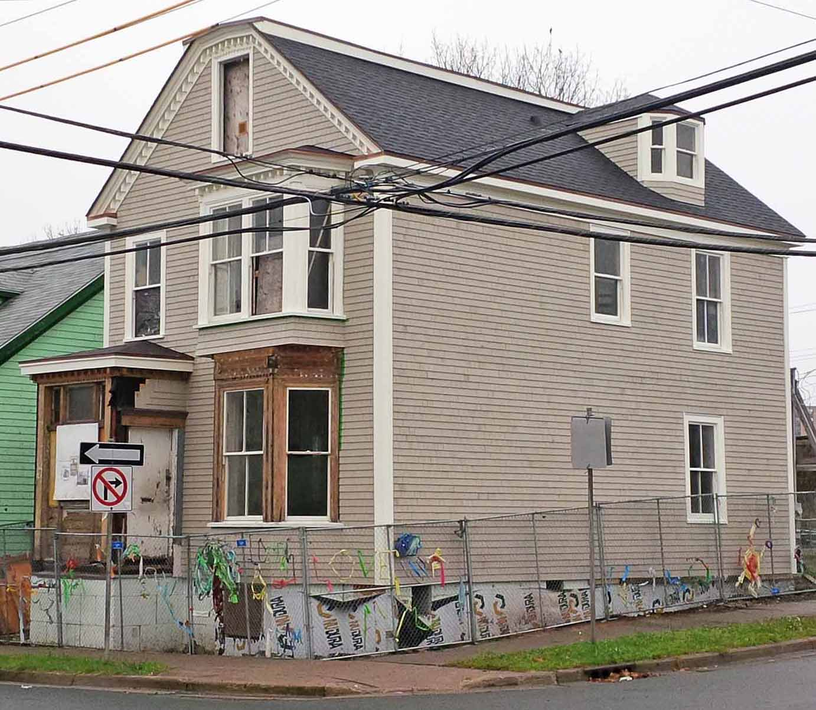
Morris House
Linda Forbes, Heritage Trust of Nova Scotia
http://thekitchensinkproject.blogspot.ca/2013_01_01_archive.html

Slide 7
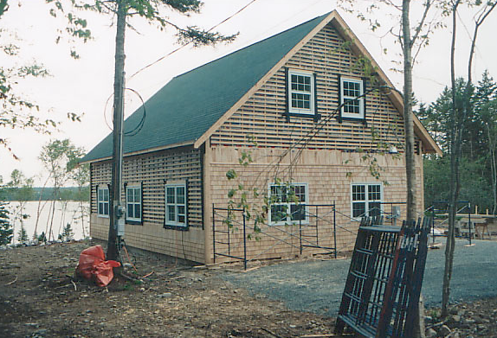
Turner’s Barn
After
Before
http://www.balticwoodworking.com/timberframing.htm

Slide 8
Timeline
The Ecology Action Centre was formed in the 1970s, from a Dalhousie University course entitled “Living Ecology.” Its first mission was to promote recycling in Halifax. Over the years, it has expanded, focusing other environmental and social issues.
In 2006, the Ecology Action Centre purchased a 130-year-old building, which it renovated into its eco-friendly office.
Finally, in 2009, the Ecology Action Centre became involved with a project started by the Heritage Trust of Nova Scotia – the Morris House.
In, 2010, it released its “Waste? NOT! Toolkit” to promote the reuse of historic buildings, and the reduction in waste.
In early 2013, the Morris House was moved across Halifax, to be repurposed as affordable housing for youth.

Slide 9
Natural/Cultural Heritage
Cultural heritage: Some buildings that are being reused may have heritage designations, however the examples discussed are not designated. Regardless, they are 250 years old, 130 years old and 180 years old respectively. They clearly have value, but the value has not been legally protected.
When working with designated or non-designated buildings, an approach of minimal intervention should be taken whenever possible. The Standards and Guidelines for the Conservation of Historic Places in Canada is an important document, and should be followed when renovating any historic building, not just one that is designated.

Slide 10
Levels of Intervention

Slide 11
Sustainability
Environmental sustainability - can help reduce waste and reduce energy consumption. Using less non-renewable resources means that more will be preserved for future generations, and less will end up in landfills. Also, reusing existing materials saves the energy that would normally be necessary to manufacture more of these materials.
Economic sustainability - reusing materials and buildings could potentially save money and conserve resources.. Overall, they encourage the conservation of resources, as well as encourage resources to be spent efficiently.
Social sustainability - historic buildings as affordable housing. An organization such as Habitat for Humanity ReStore sells recycled building materials to communities for discounted prices. Individuals and families that otherwise may not be able to afford safe housing are able to purchase quality products at low prices.

Slide 12
Stakeholders
Adaptive Reuse - Ecology Action Centre Building:
Ecology Action Centre (owner of building)
Tekton Construction (contractor)
Solterre Design (Design firm)
Volunteers (the majority of the renovation work was done by volunteers)
The community
Structure Relocation - Morris House:
Heritage Trust of Nova Scotia (owner)
Metro Non-Profit Housing (not for profit housing organization in Halifax)
the ARK (a community organization that works with homeless youth)
Halifax Regional Municipality (the municipality the development is located in)
9 occupants of the affordable housing units being built
Deconstruction and Reconstruction in a different location - Turner’s Barn:
Owner (unnamed)
Baltic Woodworking (the company hired to do the work)
Tenants of house (2 apartments in the house)
Disassembly and reuse of elements in new projects:
Habitat for Humanity ReStore
Waste Management Organizations
Municipalities
Contractors
Demolition Companies

Slide 13
References
Addis, Bill. (2006). Building with reclaimed components and materials. Bodmin: MPG Books Limited.
Athena Sustainable Materials Institute. (2009). A Life Cycle Assessment study of embodied effects for existing historic buildings. Retrieved from http://www.athenasmi.org/wp-content/uploads/2012/01/Athena_LCA_for_Existing_Historic_Buildings.pdf.
Barliant, Claire. (2010). Adaptive reuse: New strategies in response to the housing crisis. A Journal of Art, Context, and Enquiry, 23, 108-119.
Ecology Action Centre. (2010). Waste? Not! Toolkit. Retrieved from https://www.ecologyaction.ca/files/images-documents/file/Built_Environment/cdtoolkit/WasteNOT.pdf.
Ecology Action Centre. (n.d.). 2014-2015 Fern Lane expansion. Retrieved on November 22, 2014 from https://www.ecologyaction.ca/expansion2014.
Habitat for Humanity ReStore. Retrieved November 22, 2014 from http://www.habitatncr.com/index.php/restore/restore-overview.
Jeffrey, Colin. (2011). Construction and demolition waste recycling. Retrieved from http://www.dal.ca/content/dam/dalhousie/pdf/sustainability/Construction_Demolition_Waste_Recycling.pdf.
Joint Action Committee on the Morris, The. (2013). Moving the Morris House. Retrieved from https://www.ecologyaction.ca/files/images-documents/Morrisbackgrounder_January2013.pdf.
Murnaghan, Aaron and Kim Thompson. (2011). Saving the Morris Building. Retrieved from https://www.ecologyaction.ca/files/images-documents/file/Mar22_11_%20Morrisktbackgrounder_compressed.pdf.
Regional Waste Reduction Coordinators of Nova Scotia. (2013). Management guide for construction and demolition debris. Retrieved from http://www.wastecheck.ca/pdfs/2014/CandDManagementGuide.pdf.

