Slide 1
Library of Parliament in Ottawa
Atheer Alfawzan
CDNS 4403-5003
Sustainable Heritage Case Study
Class Presentation
Nov.28, 2017
Sustainable Rehabilitation of a Cultural Icon

Slide 2
The Library of Parliament
Library of Parliament Today
Library of Parliament during construction in 1857
Images from: Government of Canada

Slide 3
Lessons
The importance of the relationship between historic/cultural conservation and sustainability. There are ways that we can maintain our historic/cultural buildings and do it in a sustainable manner.
Strategies for sustainable rehabilitation include adaptive reuse, improvement of durability, and modernization of building components.
The Standards and Guidelines for the conservation of historic places in Canada and Building Resilience guidelines for the sustainable rehabilitation of buildings in Canada are excellent sources for historic conservation in Canada and sustainable redevelopment.

Slide 4
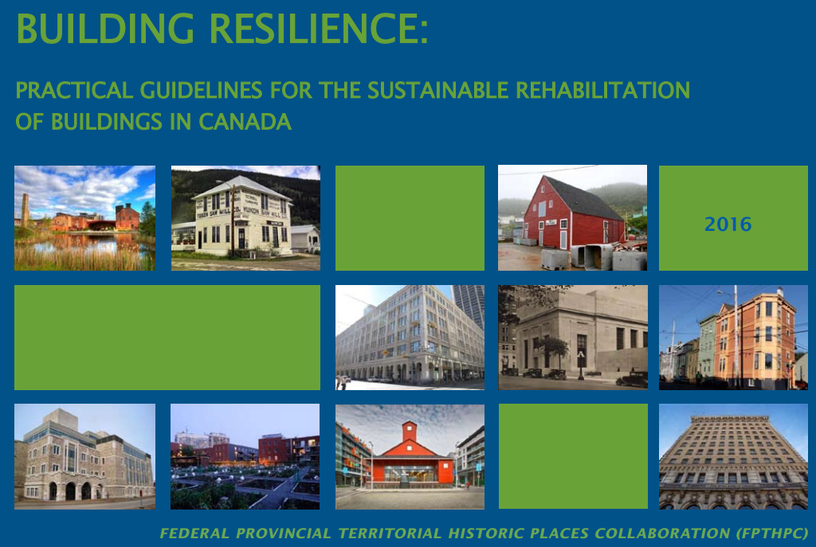
Merging sustainable rehabilitation and heritage conservation
See: Canada’s Historic Places (2010) and Ministers of Cultural Heritage in Canada (2016)

Slide 5
Description
Preservation of Existing Façade (Environmental/Cultural/Economic Sustainability):
Existing elements of the structural façade were removed, rehabilitated, and reinstalled on the building for preservation purposes. This also reserved the cultural heritage of the structure by keeping as much of the original structure as possible.
Laser cleaning of façade preserves appearance without the use of harmful chemicals.
Replacement of Lighting Systems (Environmental/Economic Sustainability):
Replacement of old incandescent light fixtures with energy efficient LED lights
Removal of Harmful Building Materials and Substances (Environmental Sustainability):
Replacement of hazardous and toxic materials with sustainable and durable alternatives ensures that the library will be a safe and functional space for many years to come.
New Window Systems for Energy Conservation (Environmental/Cultural Sustainability):
Replacement of existing windows with new more efficient window pane systems.
Preserving the quality of the light inside the library room, a character defining features.
Replacement of the Copper Roof (Environmental/Cultural/Economic Sustainability):
Parts of the roof were reused in the

Slide 6
Stakeholders
Organizations: The Crown
Director: Sonia L’Heureux, Parliamentary Librarian of Canada
Committee on the Use of Parliament Hill:
Sergeant-at-Arms
Senate
RCMP
National Capital Commission (NCC)
Privy Council Office
Department of Canadian Heritage
Source: Government of Canada (2016) House of Commons Procedures and Practices

Slide 7
Timeline
1857 – The construction of the library of parliament begins and is planned as a Gothic Revival building design in the High Victorian style. The building was designed by architects Thomas Fuller and Chilion Jones.
1876 – The library opens after completion of construction.
1916 – A fire broke out in the Centre Block of parliament. The use of heavy iron doors between centre block and the library saved the library from major structural damage
2002 – Work begins on the library of parliament building to completely modernize the exterior and interior of the structure.
2006 – Work is completed on the conservation, rehabilitation, and modernization of the library of parliament building.
Source: Government of Canada (2016) Explore the Library of Parliament

Slide 8
Natural/Cultural Heritage
The Library of Parliament was classified as a Federal Heritage building in 1987 by Parks Canada, it was classified as a national symbol of architectural and artistic merit that continues to serve its historic function in support of the operation of Parliament in Canada.
Character Defining Elements:
Exterior chapter house form of the library and the form, surfaces and fitments of its domed reading room with radiating stacks embody its heritage character;
The quality of natural light in the reading room reinforces this character. As it stands this room is a fine example of sensitive adaptation; it should continue to receive equally conscientious care
Source: Government of Canada (2016) Directory of Federal Heritage Designations

Slide 9
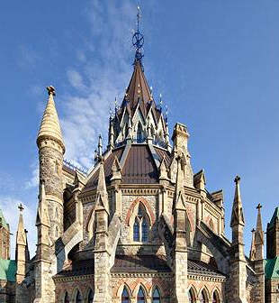
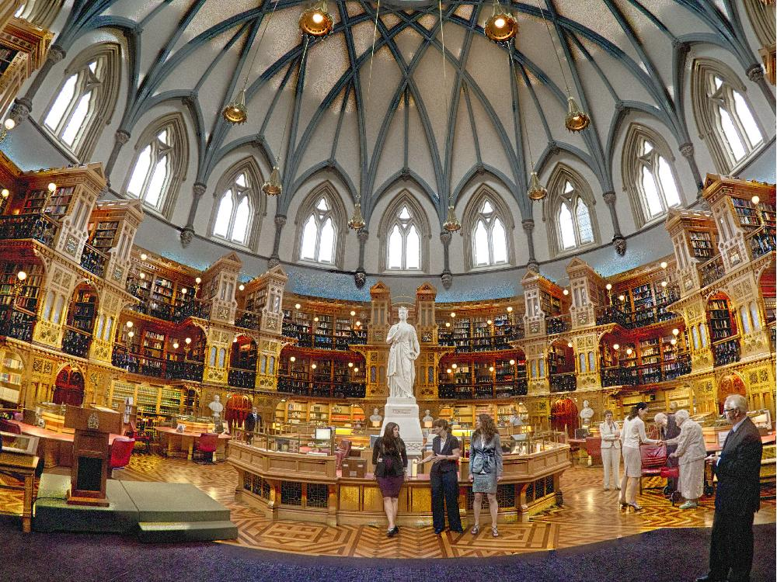
Character Defining Element of the Library of Parliament
Images from: http://photographersdirect.com and http://valinor.ca/

Slide 10
Sustainability
Environmental Sustainability:
Conserving energy, reusing/recycling materials
Socio-Cultural Sustainability:
Conserving cultural identify of the structure
Economic Sustainability:
Reducing costs and increasing service life
Source: Building Resilience: Practical Guide for the Sustainable Rehabilitation of Buildings in Canada. Ministers of Cultural Heritage in Canada

Slide 11
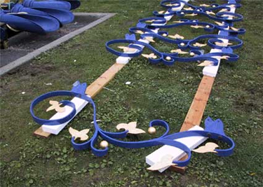
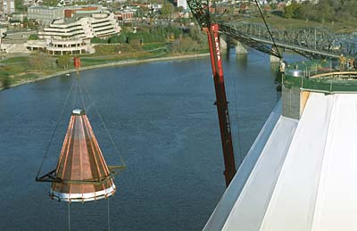
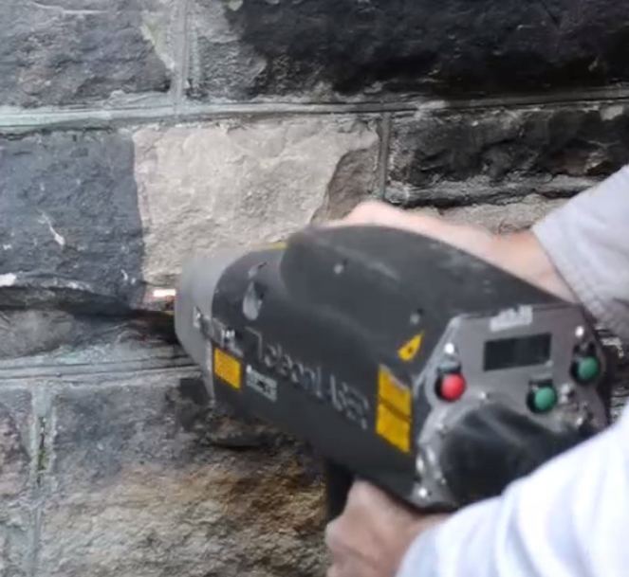
Restored Decorative Ironwork
New Copper Roof
(Old Roof Reused)
Images from:
Government of Canada and Canadian Copper and Brass Development Association
Laser Cleaning of Masonry

Slide 12
References
References
Canada, G. o. (2017). Directory of Federal Heritage Designations. Retrieved from Parliament Hill, Library: http://www.pc.gc.ca/
Canada, G. o. (2017). Explore the Library of Parliament . Retrieved from The Origins of the Library: https://www.tpsgc-pwgsc.gc.ca/
Canada, G. o. (2017). Libray of Parliament: New life for a Landmark. Retrieved from https://web.archive.org
Canada, H. (2017). Parliament . Retrieved from http://www.thecanadianencyclopedia.ca/en/article/parliament/
Canada, H. o. (2017). House of Commons Procedures and Practices. Retrieved from Parliamentary Buildings and Grounds: http://www.ourcommons.ca
Canada's Historic Places. (2010). Standards and Guidelines: for the historic conservation of historic places in Canada. Ottawa: Government of Canada.
Canadian Copper and Brass Development Association. (2017, November 26). Canadian Copper and Brass Development Association. Retrieved from Parliamentary Library: http://en.coppercanada.ca/
Direct, P. (2017). Photographers Direct. Retrieved from Library of Parliament, Ottawa, Canda: http://photographersdirect.com
Government of Canada. (2017). How Parliamentary Buildings are Rehabilitated. Retrieved from https://www.tpsgc-pwgsc.gc.ca
Ministers of Cultural Heritage in Canada. (2016). Building Resilience: Practical Guide for the Sustainable Rehabilitation of Buildings in Canada. Ministers of Cultural Heritage in Canada.
Potter, O. (2017). Libraries. Retrieved from Valinor: http://valinor.ca

