Slide 1
Conserving Winnipeg’s Modern Heritage:
Envelope Rehabilitation
Hadi Tamim
CDNS 5403
Sustainable Heritage Case Study
Class Presentation
Nov.25, 2021
The Workers Compensation Board of Manitoba Building
Acquires New High-Performance Envelope System

Slide 2
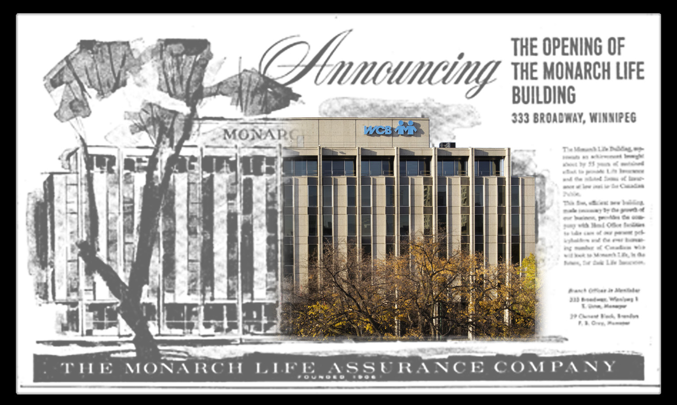
Graphic Poster Announcing Opening of Monarch Life Building Collaged with Rehabilitated Façade
Sources: Winnipeg Free Press, January 16, 1962, p.5 – Photo: Lisa Stinner-Kun.

Slide 3
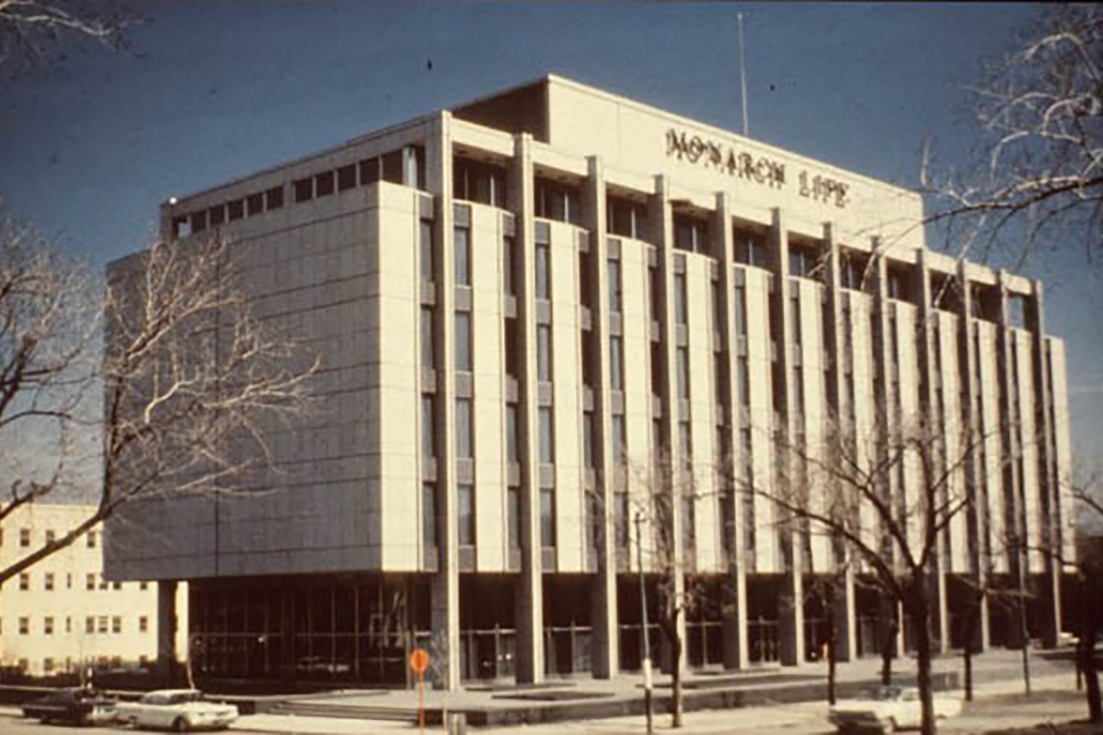
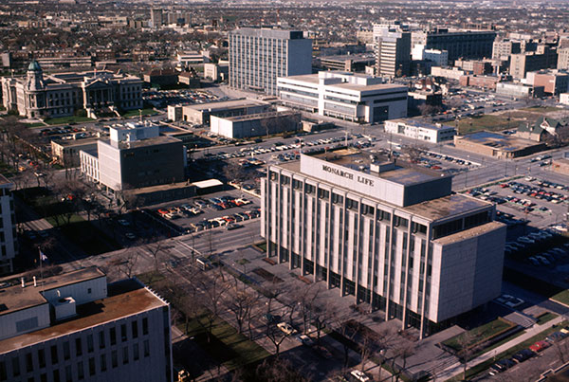
Postcard view of the Monarch Life Building (1960s)
Source: Gordon Goldsborough, 2019-0089
Aerial view of the Monarch Life Building (1960s)
Source: Planning, Property & Development, City of Winnipeg , #0160.
Key Modern Buildings in Manitoba (1960s)
Source: Winnipeg Modern: Architecture, 1945-1975 Book

Slide 4
Description
Mid-Century Office Building
Located at 333 Broadway, Winnipeg – historic and prestigious boulevard
Modernist Architecture Style: Modular Design
Historically Significant Building: Modern Heritage
Expression of Confidence and Security of Corporation
Rehabilitation and development of Building Envelope and Operational Deficiencies

Slide 5
Stakeholders
Current Owner and Restorer
Worker’s Compensation Board of Manitoba
Previous Owner
Monarch Life Assurance Company
Architect
James Donahue with Smith Carter
Restoration Consultants
Smith Carter Searle Associates
1x1 Architecture Inc.
Jurisdiction
National Building Code of Canada
Parks Canada

Slide 6
Timeline
1960 Constructed for Monarch Life Building
1999 Occupied by Worker’s Compensation Board of Manitoba
2009 Discovery of Envelope’s Deteriorated Condition
2010 National Building Code of Canada, New Building and Fire Codes
2010 Parks Canada, Historic Building Conservation New Standards
2013 Restoration Completed
2021 Municipally Designated Historic Building

Slide 7
Cultural Heritage
Designed by James Donahue: Manitoba born and trained prominent modernist architect
Mid-century modernist building, resembling age of optimism, globalization, tangible memory of vast change on political, social, cultural, technological level
Constructed at a time of population movement and societal change, from rural communities to modern society
Physical manifestation of history
Expensive material palette: Granite – instead of local limestone, for sense of establishment and security of company
Distinguishing new intervention from old cladding following conservation standards

Slide 8
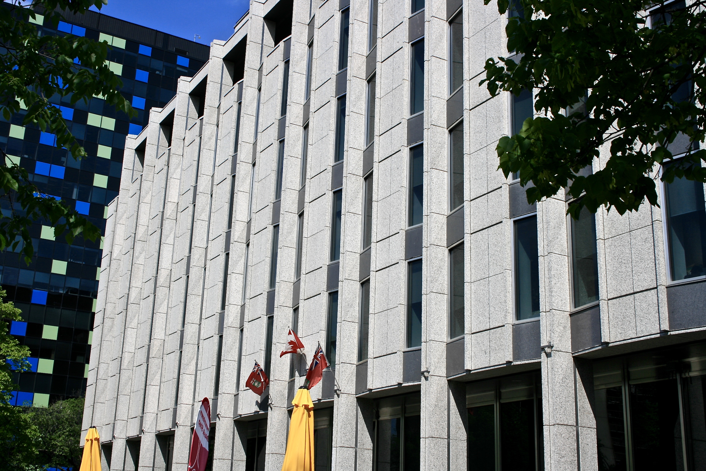
“Downtown Winnipeg has its city-share of graffiti-spattered back alleys but is mostly made up of wide formal boulevards lined with handsome stone buildings, piteously exposed despite repeated attempts at landscaping.”
- “Don't Worry About It.” The Republic of Love, by Carol Shields, National Library for the Blind, 1996.
Northeast Building View After Completion
Source: Lisa Stinner-Kun
Renovated Granite Panels
Source: winnipegarchitecture.ca/333-broadway/

Slide 9
Sustainability
Environmental Sustainability
Repair then Reinstallation of Granite Cladding instead of dumping in local landfill
Social Sustainability
Mid-century building that indicates evolution of Manitoba
Cultural Sustainability
Maintenance of heritage character of building after reinstalling existing cladding
Economic Sustainability
Increased envelope insulation to minimize thermal bridging
UN Sustainable Development Goals
SDG Goal 9: industry, innovation, infrastructure
SDG Goal 11: Sustainable Cities and Communities

Slide 10
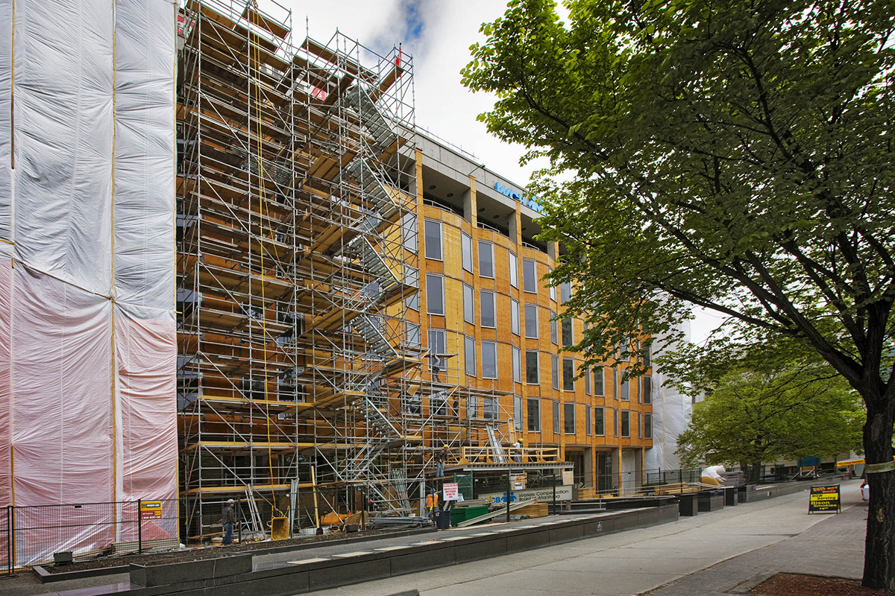
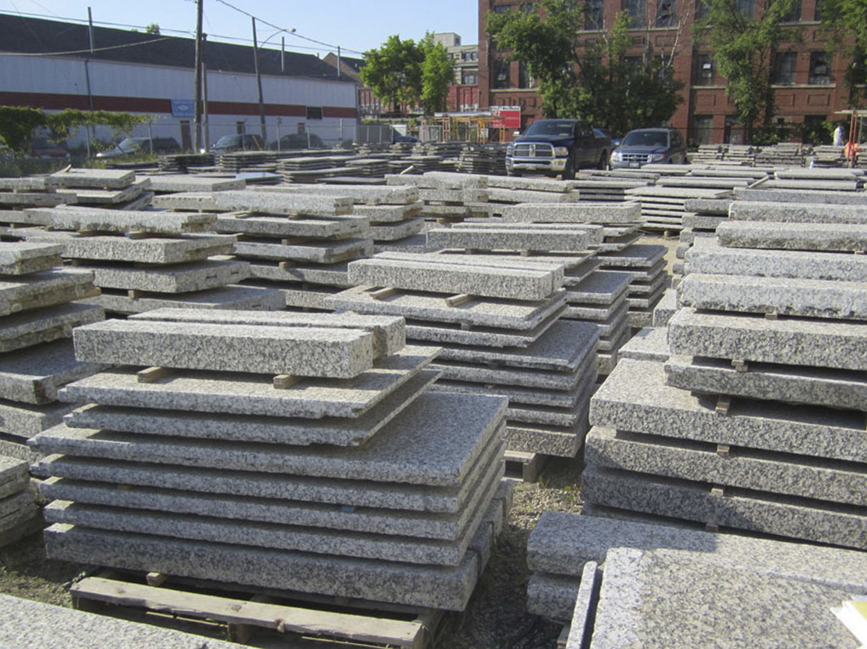
Condition behind removed stone cladding panel
Source:John Wells, Crosier Kilgour and Partners Ltd.
Temporary Wood Cladding for Insulation
Source: buildingresilience.ca
Restored Granite Cladding Panels
Source: buildingresilience.ca

Slide 11
Measurement
Parks Canada Standards and Guidelines for the Conservation of Historic Places (Parks Canada 2010) Standards 11 and 12 relating to rehabilitation in material palette of added materials, compatibility, distinguishable, reversible
National Building Code of Canada (Canadian Commission on Building and Fire Codes 2010, C17) Facade suitable for respective climatic conditions
Canadian Standards Association CSA A371 Masonry Construction for Buildings, standard for masonry construction from NBC
Performance improvements of building envelope

Slide 12
Lessons
Rehabilitation Conservation Approach
Repair and Reuse of Existing Granite Cladding
Diminishing Waste
Maintenance of High Heritage Value in Original Appearance
Building Envelope Enhancement in Energy Performance
Meeting NBC Requirements
Preservation of Winnipeg’s Modernist Heritage

Slide 13
References
Books
“Workers Compensation Board of Manitoba.” Managing Energy Use in Modern Buildings Case Studies in Conservation Practice, by Bernard Flaman et al., Getty Conservation Institute, Los Angeles, 2021.
Enns, Herbert, and Serena Keshavjee. Winnipeg Modern Architecture, 1945 to 1975. University of Manitoba Press, 2014.
Policies and Reports
National Building Code of Canada. National Research Council Canada, Institute for Research in Construction, 2015.
Normes Et Lignes Directrices Pour La Conservation Des Lieux Patrimoniaux AU Canada = Standards and Guidelines for the Conservation of Historic Places in Canada. Parcs Canada, 2010.
Modern Architecture in Manitoba - Province of Manitoba. www.gov.mb.ca/chc/hrb/internal_reports/pdfs/modern_architecture_intro.pdf.
Websites
“Workers Compensation Board.” 1x1 Architecture, 1x1architecture.ca/filter/Institutional/Workers-Compensation-Board.
“Workers Compensation Board Buildingwinnipeg, Manitoba.” Workers Compensation Board Building | Prairie Design Awards, www.prairiedesignawards.com/2014/wcb_building.html.
“Workers Compensation Board, 333 Broadway.” Crosier, Kilgour & Partners " Workers Compensation Board, 333 Broadway, ckpeng.com/structural-design/workers-compensation-board-333-broadway/.
“Developing Winnipeg’s Urban Landscape for More than 60 Years.” The Canadian Business Journal, 13 Dec. 2017, www.cbj.ca/crosier-kilgour-partners-ltd/.

